Slide 1
Bioinformatics Pipeline Overview

Slide 2
Illumina fastq file format

Slide 3
ITS2 Region
Linker
N’s
F
R
N’s
Linker
BC
Linker
Linker
BC

Slide 4

Dada2!
#39 with Benjamin Callahan
Notes:
Will talk about alternative pipelines (like symportal during wrap up)

Slide 5
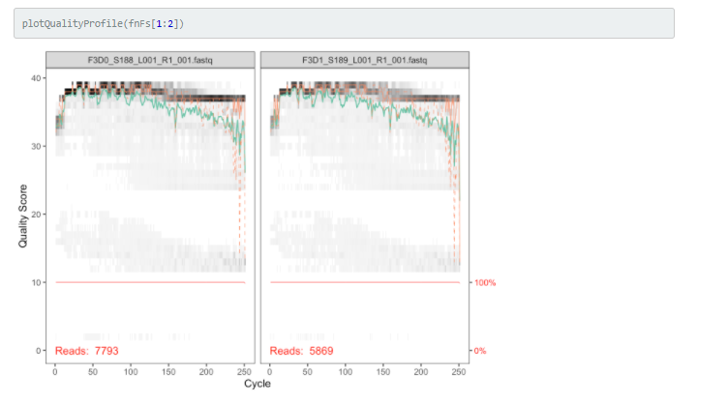
Inspect quality profiles and trim reads

Slide 6
Remove primers
ITS2 Region
Linker
N’s
F
R
N’s
Linker
BC
Linker
Linker
BC
Notes:
Note on paired end you can afford to cut a little more because you will have the reverse read to make up for it.

Slide 7
Remove primers
ITS2 Region
Linker
N’s
F
R
N’s
Linker
BC
Linker
Linker
BC
Notes:
Note on paired end you can afford to cut a little more because you will have the reverse read to make up for it.

Slide 8
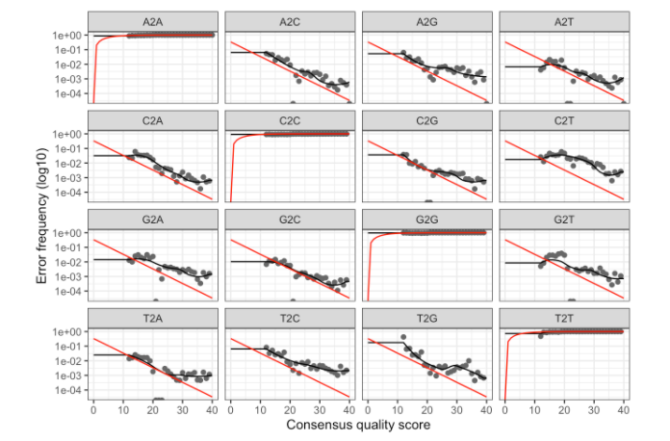
Dada2! Machine learning error rates
Notes:
Machine learning sequencing error rates, dots are actual, black bar is predicted

Slide 9
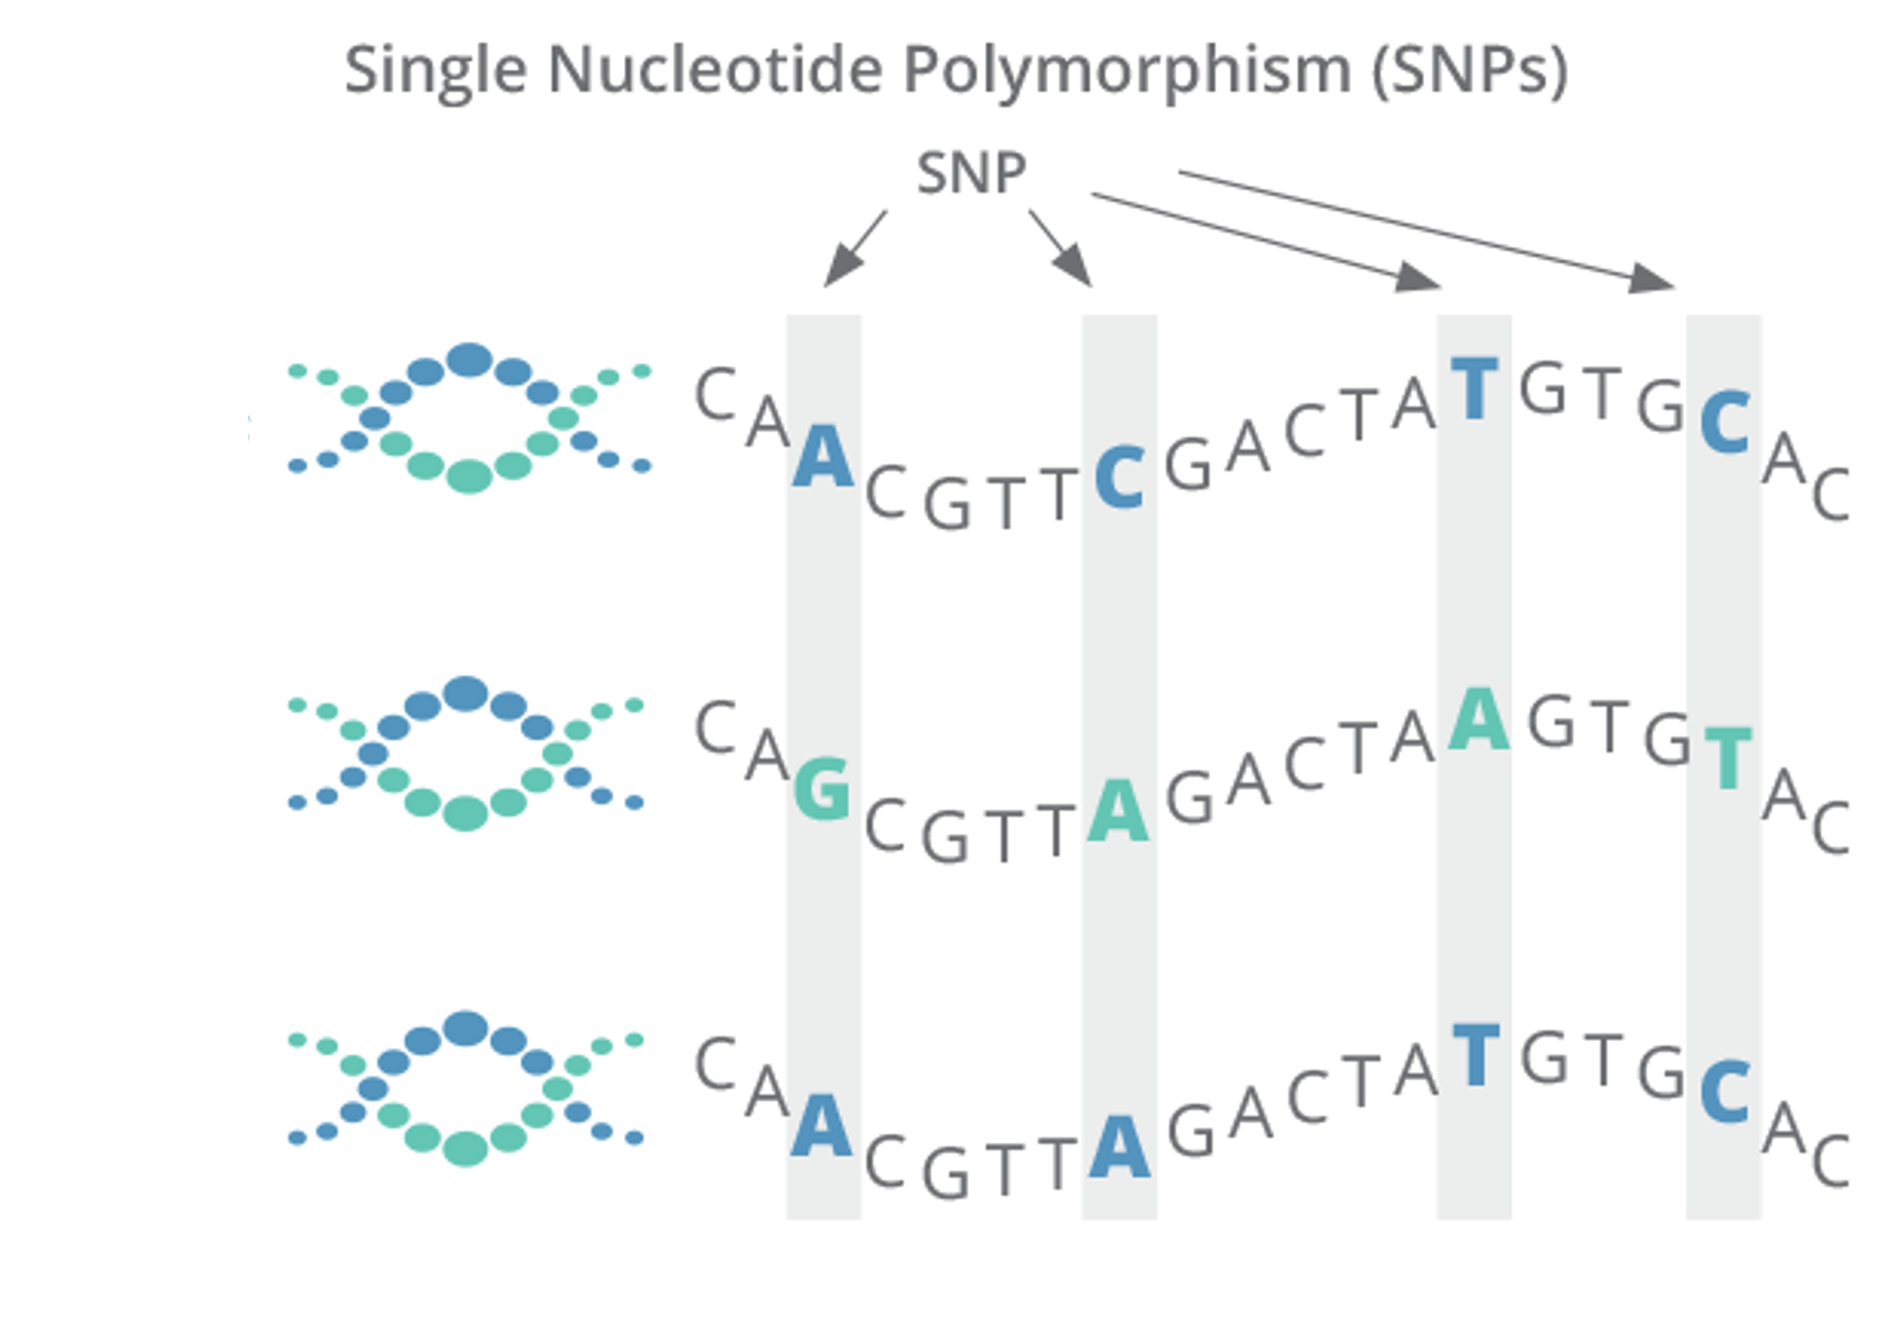
Dada2! OTUs vs ASVs
Notes:
DADA2’s computational scaling gains come from the fact that it infers sequences exactly rather than constructing OTUs. What does that mean? Lets say we have sequences for three different microbes, if they are really similar (like within genus for example) they might have very similar sequences.

Slide 10
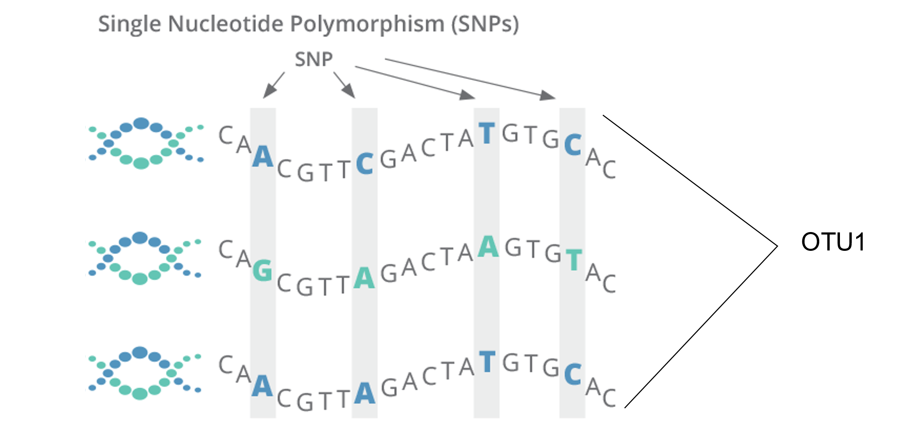
Dada2! OTUs vs ASVs
Notes:
OUT based analysis will take sequences over some threshold of similarity and group them together with an OUT label.

Slide 11
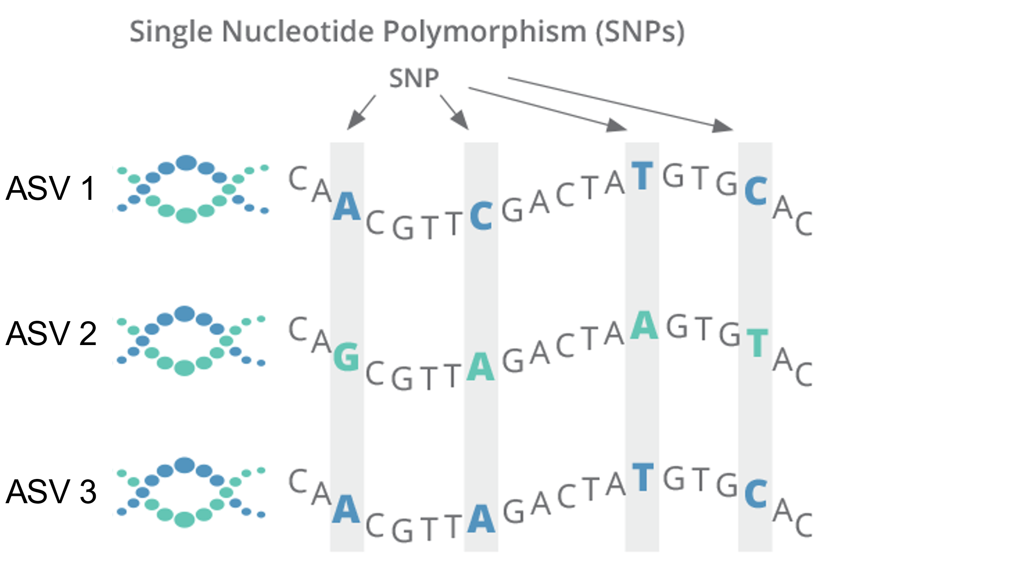
Dada2! OTUs vs ASVs
Pros? Cons?
Notes:
DADA2’s computational scaling gains come from the fact that it infers sequences exactly rather than constructing OTUs. De novo OTUs cannot be compared across samples unless all samples were pooled during OTU construction. Only negative that I’ve found is ASVs break richness estimates because of lower number of singletons.

Slide 12
Dada2! Generates consensus sequences for ASVs
Notes:
Dada2 generates ASVs using the estimated error rates

Slide 13
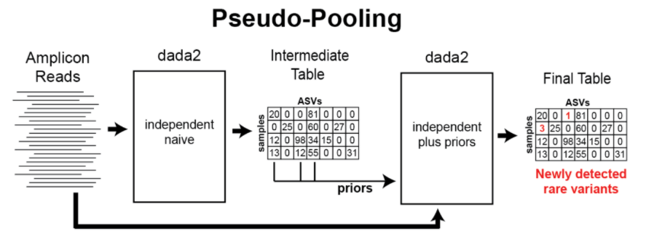
Default
Notes:
Clustering ASVs in dada2, three methods:
Indepdent, pooled, pseudo pooled.
Default=Independent, samples are processes independently.

Slide 14
Pool=TRUE
Pool across samples
Notes:
Indepdent, pooled, pseudo pooled.
Default=Independent, samples are processes independently.
pooling allows information to be shared across samples, which makes it easier to resolve rare variants that were present as singletons or doubletone in one sample but were present many times across samples.

Slide 15
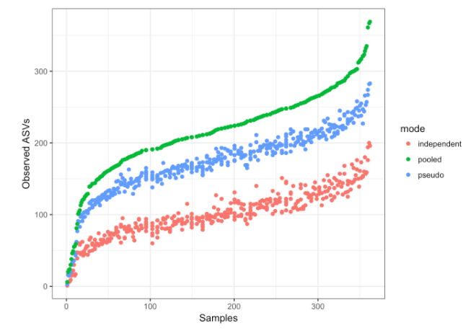
Conclusion: Use pool=TRUE when you can!
Notes:
Indepdent, pooled, pseudo pooled.
Default=Independent, samples are processes independently.

Slide 16
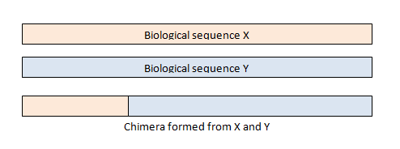
Removing Chimeras

Slide 17
Removing Chimeras

Slide 18
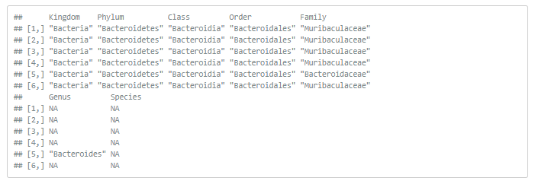
Assign taxonomy
Downside of giving dada2 a specific dataset to train on?
Notes:
#DADA2 provides a native implementation of the RDP's naive Bayesian classifier. The assignTaxonomy function takes a set of sequences and a training set of taxonomically classified sequences, and outputs the taxonomic assignments with at least minBoot bootstrap confidence.

Slide 19
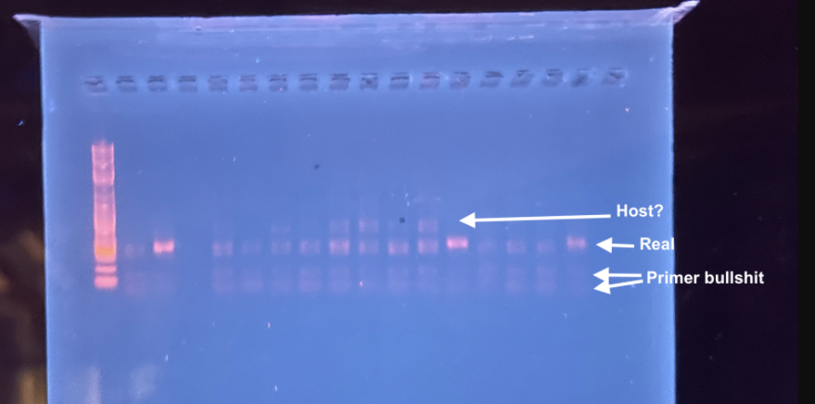
Remove contaminants (will be skipping in WS)
Remove negative control ASVs
Check external DB and remove undesired sequences (eukaryotic if using 16S data)
If you have 16S you will also need to remove unwanted mitochondrial and chloroplast ASVs (host and symbiont contamination)

Slide 20
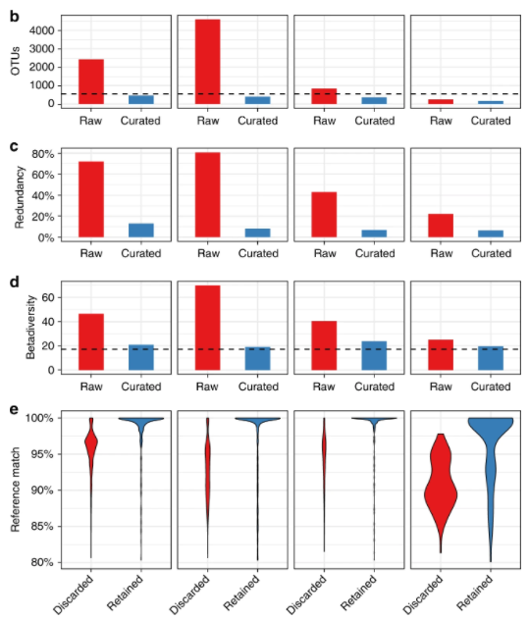
Lulu clustering (ITS2 only: reduces taxonomic redundancy)
Froslev et al 2017
Notes:
https://www.nature.com/articles/s41467-017-01312-x Froslev et al 2017.

Slide 21
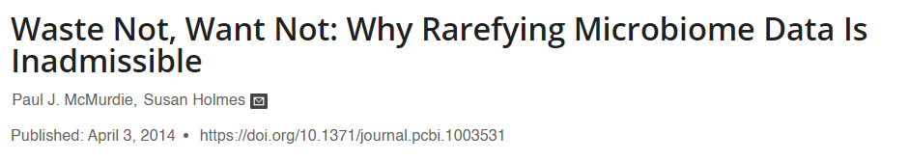
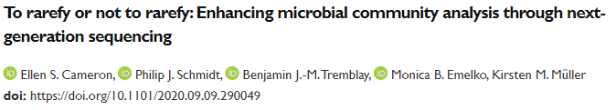
Rarefying* CONTROVERSIAL
Notes:
However, rarefying has been criticized as a normalization technique because data can be omitted through the exclusion of either excess sequences or entire samples, depending on the rarefied library size selected. Although it has been suggested that rarefying should be avoided altogether, we propose that repeatedly rarefying enables (i) characterization of the variation introduced to diversity analyses by this random subsampling and (ii) selection of smaller library sizes where necessary to incorporate all samples in the analysis. REGARDLESS SOME TYPE OF NORMALIZATION IS ESSENTIAL
INADMISSIBLE

Slide 22
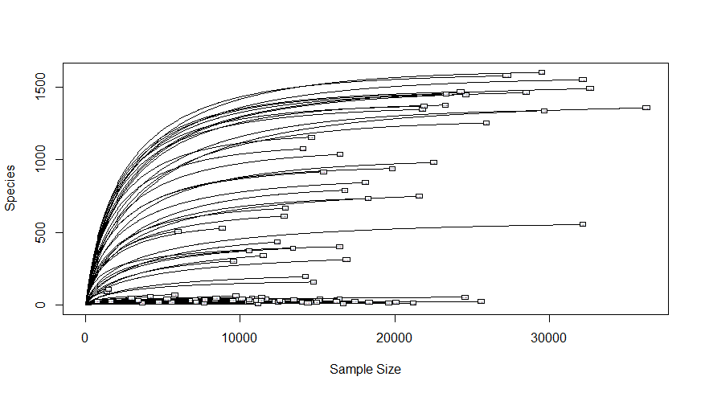
Rarefying* CONTROVERSIAL
Notes:
However, rarefying has been criticized as a normalization technique because data can be omitted through the exclusion of either excess sequences or entire samples, depending on the rarefied library size selected. Although it has been suggested that rarefying should be avoided altogether, we propose that repeatedly rarefying enables (i) characterization of the variation introduced to diversity analyses by this random subsampling and (ii) selection of smaller library sizes where necessary to incorporate all samples in the analysis. REGARDLESS NORMALIZATION IS ESSENTIAL

Slide 23
Rarefying* CONTROVERSIAL
Notes:
However, rarefying has been criticized as a normalization technique because data can be omitted through the exclusion of either excess sequences or entire samples, depending on the rarefied library size selected. Although it has been suggested that rarefying should be avoided altogether, we propose that repeatedly rarefying enables (i) characterization of the variation introduced to diversity analyses by this random subsampling and (ii) selection of smaller library sizes where necessary to incorporate all samples in the analysis. REGARDLESS NORMALIZATION IS ESSENTIAL

Slide 24
Rarefying* CONTROVERSIAL
Notes:
However, rarefying has been criticized as a normalization technique because data can be omitted through the exclusion of either excess sequences or entire samples, depending on the rarefied library size selected. Although it has been suggested that rarefying should be avoided altogether, we propose that repeatedly rarefying enables (i) characterization of the variation introduced to diversity analyses by this random subsampling and (ii) selection of smaller library sizes where necessary to incorporate all samples in the analysis. REGARDLESS NORMALIZATION of some kind IS ESSENTIAL to account for differences in lib size

Slide 25
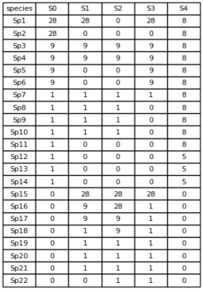
Trimming low abundance ASVs and removing outlier samples
Notes:
Samples that have almost no reads for any taxa would be removed (bottom row.) ASVs that only appear a few times across all sample would be removed.

Slide 26
Overview
Obtain fastq files and do some pre-processing
Trim off low quality base pairs & remove primers
Use dada2 to estimate error rates and transform reads into ASVs (produces counts file)
Use dada2 to remove chimeras
Check read stats to ensure reasonable amount of info is left
Assign taxonomy using dada2
Additional filtering (e.g. remove negative control)
Apply lulu (if using ITS2)
Rarefy
Trim low abundance OTUs and remove outliers
Visualize, assess diversity and do other wacky stuff
Notes:
However, rarefying has been criticized as a normalization technique because data can be omitted through the exclusion of either excess sequences or entire samples, depending on the rarefied library size selected. Although it has been suggested that rarefying should be avoided altogether, we propose that repeatedly rarefying enables (i) characterization of the variation introduced to diversity analyses by this random subsampling and (ii) selection of smaller library sizes where necessary to incorporate all samples in the analysis. REGARDLESS NORMALIZATION of some kind IS ESSENTIAL to account for differences in lib size

